Slide 1
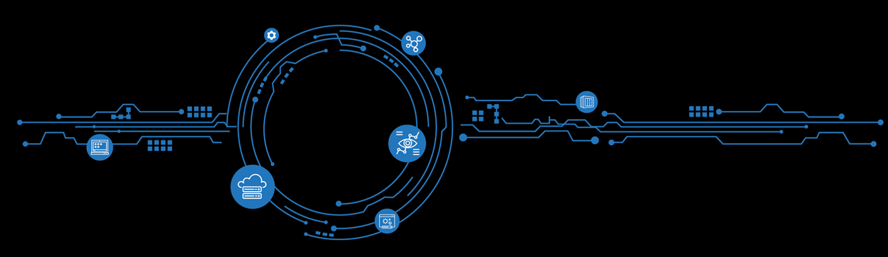
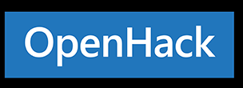



DevOps
<Event Date>
<Event Location>
SSID: OpenHack | PW: Microsoft
#MSOpenHack
Notes:
Welcome to OpenHack!
Thank you for being here!
My name is Tristan Gorringe, I’m a PM in Commercial Software Engineering and I’ll be leading you through the OpenHack experience along side Dariusz Porowski who is an Engineer also in CSE
How many are attending Ready for their first time?
How many are attending their first OpenHack?

Slide 2
What is OpenHack?
+
Open
Hack
A wide variety of participants
Hands-on experimentation using challenge-based content
Notes:
What is OpenHack?
Microsoft OpenHack is a technical upskilling experience where a wide variety of participants (Open) learn through hands-on experimentation (Hack) using challenges based on real world customer engagements designed to mimic the developer journey.
OpenHack is a premium Microsoft event that provides a unique upskilling experience for employees, customers, and partners.
This format is hands-on, challenge-based hacking using priority tech, leverages expert coaches and public documentation to solve real-world scenarios blocking adoption and service usage.

Slide 3



What is OpenHack?
Customers/Partners
Challenge-based: increasing difficulty
Team-based: work together and communicate
Immersive: real-world scenario
Feedback: improve product offerings through a direct feedback loop with Engineering and Documentation
Notes:
What is OpenHack?
Challenged-based – increasing difficulty
Team-based – work together and communicate, your team is your family for the next three days
Immersive – real-world scenarios
Feedback – improve product offerings through direct feedback loop with engineering and documentation

Slide 4
Tips for a successful OpenHack
Be curious, ask 'Why not?’, it’s safe to explore!
Pay attention to the challenge details
Collaborate with other hackers, share knowledge
Split the work up, leverage your whole team!
Everyone should be hacking, learning, and solving
Notes:
Be curious, ask questions. It’s safe to explore
Read the documentation and challenge details
Collaborate with those on your team and other team tables
Split up the work, leverage the whole team
Everyone should be immersed in OpenHack – hack, learn and solve the challenges

Slide 5
Expectations of Coaches
Provide guidance
Keep the team on track
Treat blockers as learning opportunities
Capture feedback, both positive and negative
Not to give the solutions!
Notes:
Ask coach to stand up and wave
These are your coaches; they are here to guide you through the challenges. Ask questions! They are here to help if you get stuck but not give you the solution

Slide 6
Agenda
Timeslot | Tuesday, September 17 | Wednesday, September 18
7:30 – 8:00 | US DTA Corenote
8:00 – 8:30
8:30 – 9:00 |  | Daily announcements + feedback (survey)
9:00 – 9:30 |  | Team hacking
9:30 – 10:00
10:00 – 10:30
10:30 – 11:00
11:00 – 11:30 | OpenHack kickoff
11:30 – 12:00 | Team hacking
12:00 – 12:30 | Lunch + continued hacking | Lunch + continued Hacking
12:30 – 1:00
1:00 – 1:30 | Team hacking | Team hacking
1:30 – 2:00
2:00 – 2:30
2:30 – 3:00
3:00 – 3:30
3:30 – 4:00
4:30 – 5:00
5:00 – 5:30
5:30 – 6:00 |  | Closing remarks
6:00 – 6:30 |  | End of OpenHack
6:30 – 7:00

Slide 7

Important Links – Migration
SSID: OpenHack | PW: Microsoft
OpenHack Portal: https://openhack.skillmeup.com
Login: 84104-43adc-#@skillmeup.com
PW: Password123
Table # i.e. 1

Slide 8
OpenHack Code of Conduct
Microsoft’s mission is to empower every person and every organization on the planet to achieve more. This includes at Microsoft Migration dry-run where we seek to create a respectful, friendly, and inclusive experience for all participants. As such, we do not tolerate harassing or disrespectful behavior, messages, images, or interactions by any event participant, in any form, at any aspect of the program including business and social activities, regardless of location.
We do not tolerate any behavior that is degrading to any gender, race, sexual orientation or disability, or any behavior that would violate Microsoft’s Anti-Harassment and Anti-Discrimination Policy, Equal Employment Opportunity Policy, or Standards of Business Conduct. In short, the entire experience at the venue must meet our culture standards.
We encourage everyone to assist in creating a welcoming and safe environment. Please report any concerns, harassing behavior, suspicious or disruptive activity to the nearest security guard or show staff. Microsoft reserves the right to refuse admittance to, or remove any person from OpenHack at any time, in its sole discretion. ohupdate@microsoft.com
Notes:
There are a lot of words on the this slide… rather than read it to you I will summarize it for you…
Be a decent person and respect your team / peers / coach
If you have any issues please let me know

Slide 9
Social Media
Please feel free to take photos and share* on Social Media
#MSOpenHack #OpenHack #DevOps
* Do not share Content and Solutions!

Slide 10

OpenHacks Worldwide
Internal @ aka.ms/CSEOpenHackCalendarPBI
External @ openhack.microsoft.com

Slide 11
What is the Technical Skills Initiative?
Designed to deepen your technical capabilities and mastery of Microsoft solution areas, TSI helps you exceed customer and partner expectations so that you can achieve success.
Participants:
Learn and build technical skills in Microsoft's core solutions.
Showcase certifications and achievements through social media.
Stay current on existing certifications.
The Technical Skills Initiative (TSI) is a role-based approach to learning that delivers a set of technical certifications and achievements.
Notes:
To address learner needs in FY20, the Technical Skills Initiative delivers achievements and certifications to build deeper core sales, technical, and solution knowledge.

Slide 12




Technical Skills Initiative Roles
Role-based learning to build technical skills aimed at driving business outcomes
Learning paths leading to Achievements and Certifications
Technical roles focus on hands-on skills to shift from “knowing” to “doing”
Hands-on Skills (OpenHack)
Learners to complete annual “stay current” requirements for
Achievements and Certifications
Technical Certification
Fundamentals Certification
(Except ATU & non customer-facing roles)
Requirements Specific to Solution Areas
Azure, M365, & D365
Microsoft Business Achievement
GENERALIST
SPECIALIST
TECHNICAL
TECHNICAL DEPTH
Notes:
Talking points
To address learner needs in FY20, the Technical Skills Initiative delivers achievements and certifications to build deeper core sales, technical, and solution knowledge.
For Technical sellers, TSI will help to certify their deep technical skills, which will be demonstrated by maintaining one role-based technical certification. For Intelligent Cloud roles, there will also be an opportunity to participate in an OpenHack, a hands-on developer focused event.
For Specialist sellers, TSI will help them attain a deeper knowledge in their primary Solution Area and broad knowledge across other solution areas. This will be demonstrated typically by a combination of fundamental certifications and achievements.
For all Microsoft employees, TSI will help them learn the latest information about our priority commercial Solution Areas through three achievement trainings, along with a fundamental certification for most roles.

Slide 13
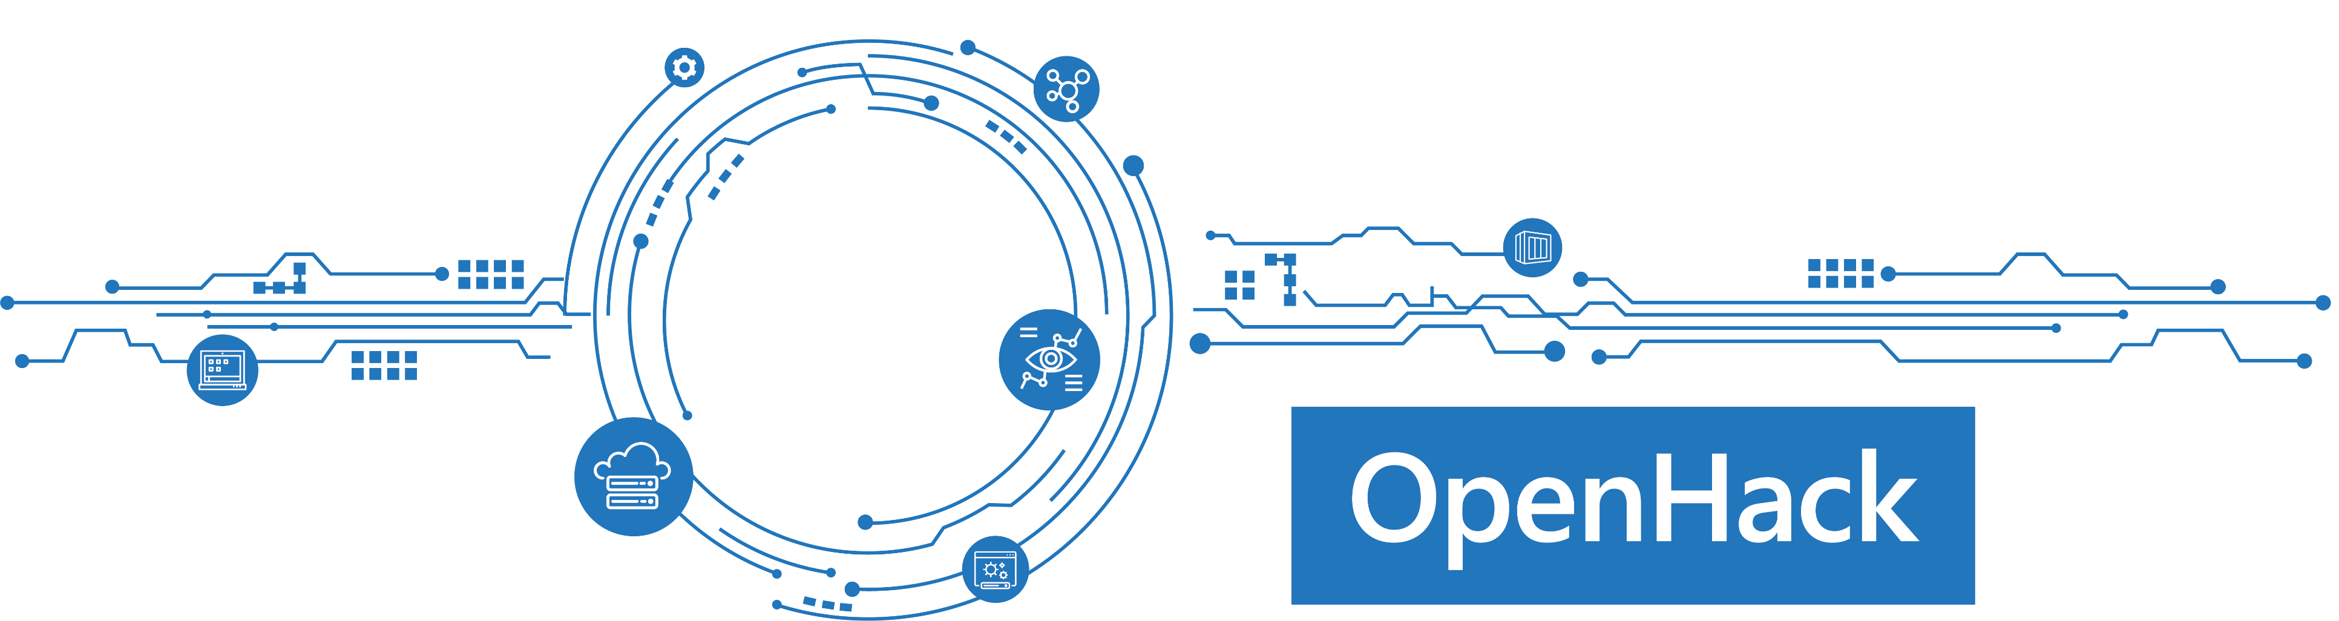
TSI Requirements
1. Full Attendance
2. Engagement and Participation
3. Challenge Completion
Notes:
To meet the TSI requirements for Challenged-Based Learning, we need you to do a few simple things at this OpenHack in order to get full credit!
Full Attendance Required – you need to be physically here. Both days. Morning and Afternoon.
Engagement and Participation Required – we need you to be present, focused, not doing emails or taking calls. Lean in with your team and get the most out of the experience!
Challenges Completed – the scenarios have been designed to get progressively more challenging. AND, they aren’t easy. You’ll get frustrated. Coaches are here to help guide you, however they won’t give you answers. Its expected that you’ll reach conclusions and solutions as a team and continue moving on to the next set of challenges. So we want you to take your time, dive deep – but balance that with covering a bit of ground so you can be exposed to additional challenges and knowledge we’re
For those that didn’t have time/ability to complete the necessary challenges for TSI credits, there will be other opportunities at future readiness events. DTA, Winter Ready, etc. So don’t stress. This is going to be a FUN couple of days!!!!

Slide 14
DevOps Tech Scenario

Slide 15
Why DevOps OpenHack?
The challenges in this DevOps OpenHack are based on real world scenarios identified by engineering teams at Microsoft working to solve customers problems deploying to the cloud.
Notes:
Ask ops focused vs devs. Talk about how de ops applies.
Continuous Integration – We regularly engage with partners who want to use DevOps to increase their quality and reduce time to release. The challenges around CI help partners/customers formulate a comprehensive and viable CI strategy.
Continuous Deployment – Deploying updates anytime with zero downtime is key to achieving a fast feedback loop that helps increase project velocity. Equally important is safe rollback. These two capabilities enable teams to focus on enabling capabilities and minimize operational focused activities.
Monitoring- A key part of any deployment strategy is solid and simple monitoring. Monitoring that allows you to quickly understand if the service ie healthy but zero in on problems when they arise is key to ZDD.

Slide 16
Event Structure
Focus Areas
Continuous Integration
Continuous Deployment
Monitoring
Difficult problems
Build cool stuff
Fundamentals
Basic functional pipeline with Blue/Green support

Slide 17
Event Goals
Have fun while learning about DevOps through doing
DevOps is about repeatable and predictable velocity through automation
REMEMBER: There are many ways to solve each problem

Slide 18

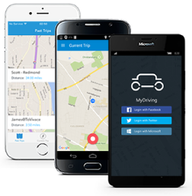
OpenHack Theme
Your team is the IT team of a fictitious insurance company that runs the MyDriving Service.
The company is offering their customers the ability to evaluate their driving skills.
A mobile application collects the data from the car and sends them to a set of APIs which evaluate the trip that has just been completed.
Your customers can connect to a web application that uses the same APIs to review their trips and their driving score. Any downtime of the APIs would greatly impact your business.
Your mission, should you accept it, is to update the APIs to incorporate any business requirements while keeping the application functional.
The success of your team depends on your ability to perform those updates by applying DevOps focused practices to build, test, deploy, and monitor the MyDriving Services. If done properly you will not incur downtime and have visibility of your application throughout the entire process.
Notes:
Your mission, should you accept it, is to update the APIs to incorporate any business requirements while keeping the application functional.

Slide 19
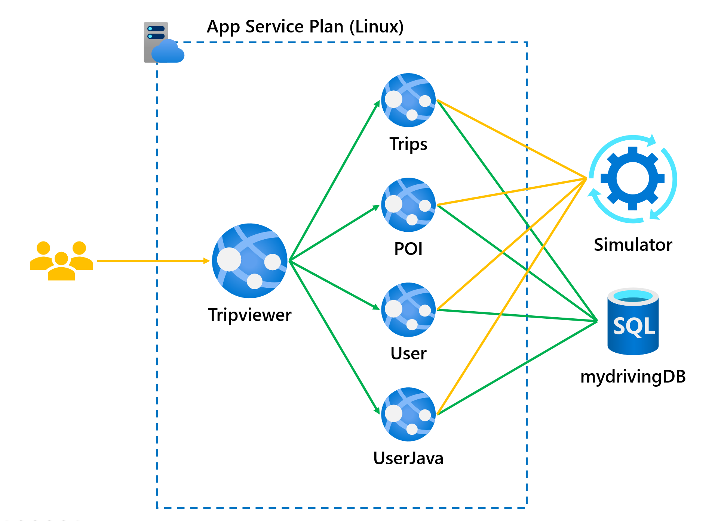
Architecture – Application and Application APIs
5 Azure Web Apps for Containers each with a staging deployment slot running the following applications
Tripviewer - the team website that your customers are using to review their driving scores and trips which are being simulated against the APIs.
Trips - the trips API is where the mobile application sends the trip data from the OBD device to be stored.
POI - the POI (Point Of Interests) API is collecting the points of the trip when a hard stop or hard acceleration was detected.
User – the user profile API is used by the application to read the user's information.
User-Java - the user (Java) API is used by the application to create and modify the users.

Slide 20
DevOps is a team sport 1 - People 2 - Process 3 - Technology

Slide 21
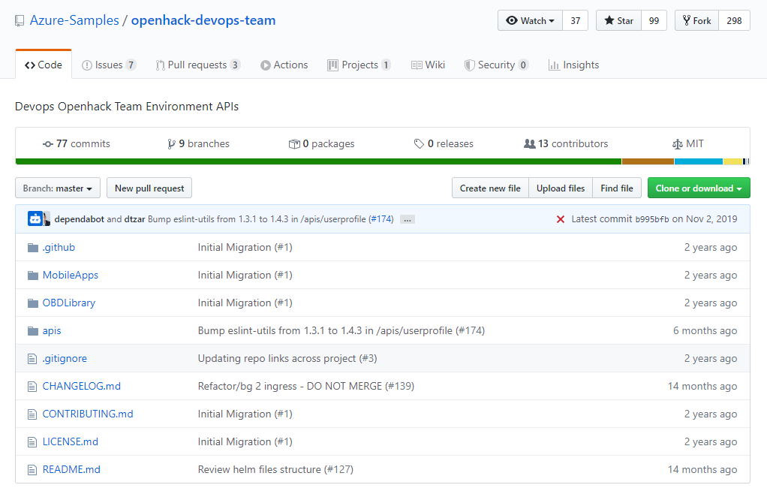
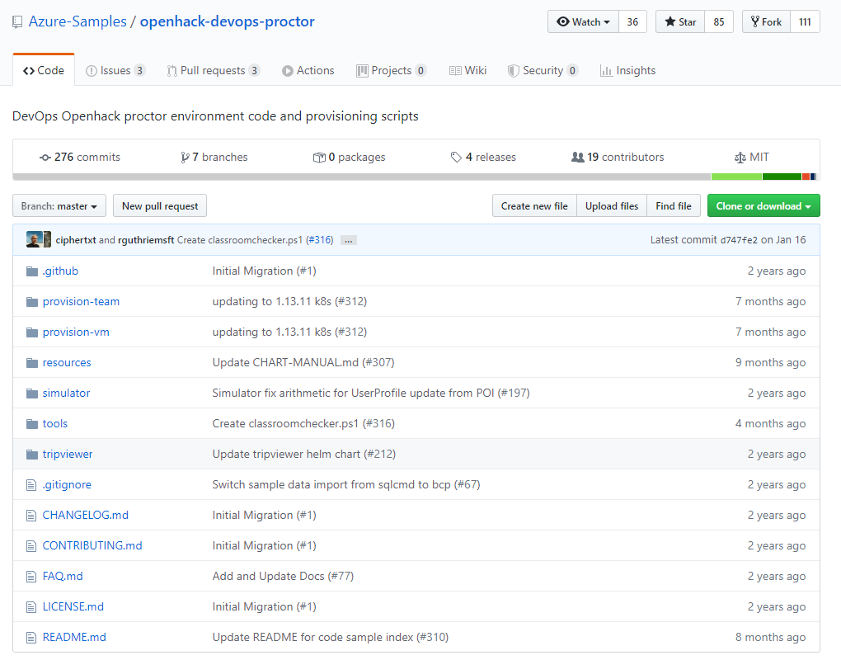
Source code
Micro-services code (APIs)
http://aka.ms/dohteam
Deployment scripts
http://aka.ms/dohproctor

Slide 22
Tools
Azure services and tools
Azure DevOps
Azure App Service
Azure Web Apps for Containers
Azure Key Vault
Azure SQL Database
Azure Container Instances
Azure Container Registry
Open source services and tools
GitHub
Jenkins
Editor of your choice
VS Code, Sublime, etc.
Azure CLI/Azure PowerShell
Notes:
Reinforce Jenkins vs VSTS

Slide 23
Connecting to your environments
Navigate to the OPEN HACK ENVIRONMENT tab
The usernames and passwords provided can be used to access your Azure subscription
Search for the resource tripviewer, or alternatively, browse to App Services in the Azure portal and locate the App Service that ends with tripviewer
Browse to the App Service and note the URL in the Overview blade.
Clicking the URL will bring up the Tripviewer application

Slide 24
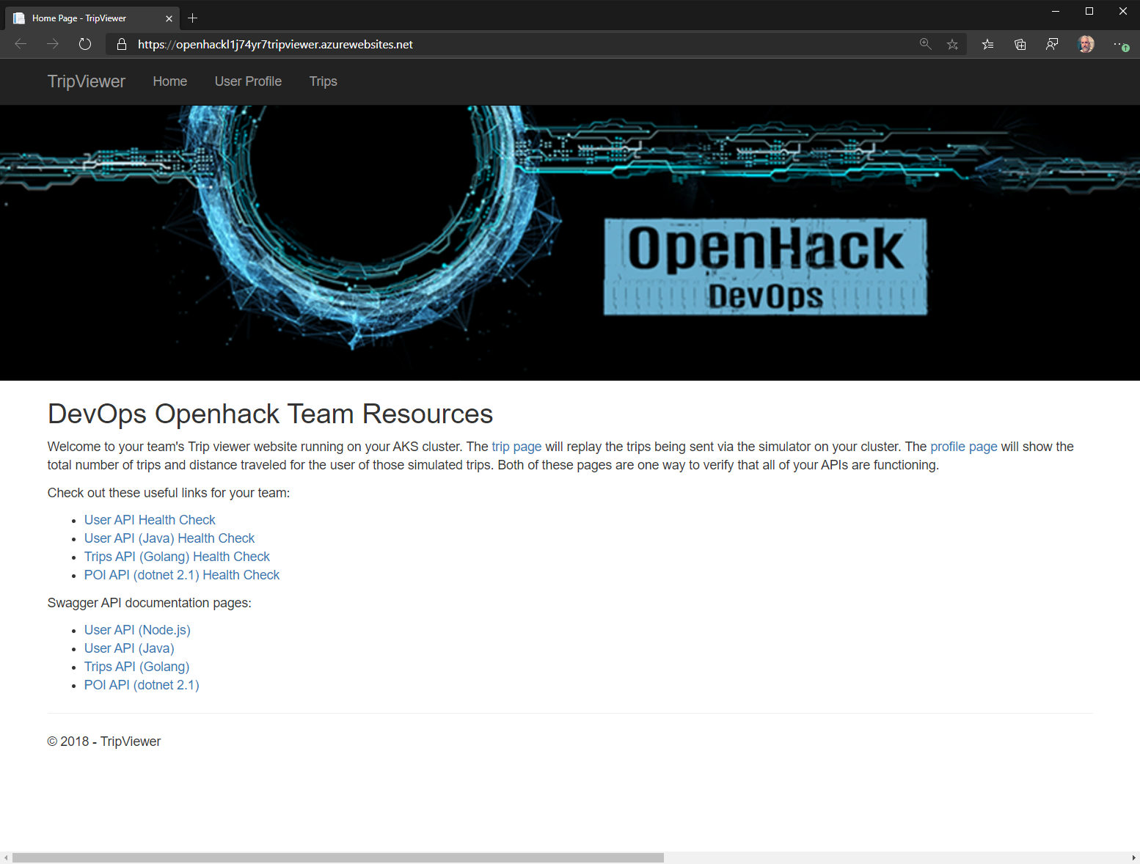
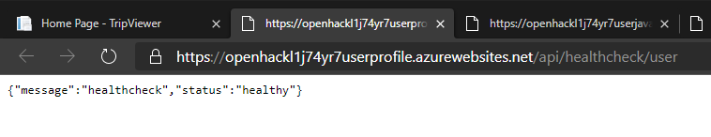

Tripviewer application.

Slide 25
Environment Demonstration

Slide 26
Notes:
Welcome to OpenHack!
Thank you for being here!
My name is Tristan Gorringe, I’m a PM in Commercial Software Engineering and I’ll be leading you through the OpenHack experience along side Dariusz Porowski who is an Engineer also in CSE
How many are attending Ready for their first time?
How many are attending their first OpenHack?

